Slide 1
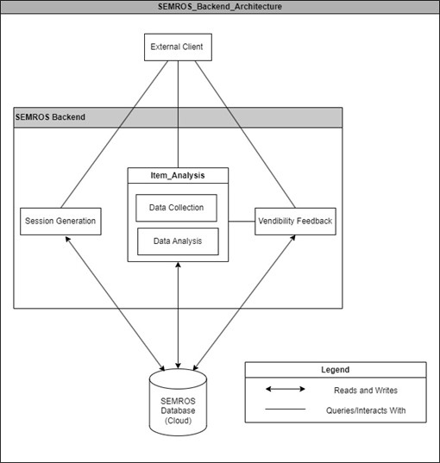
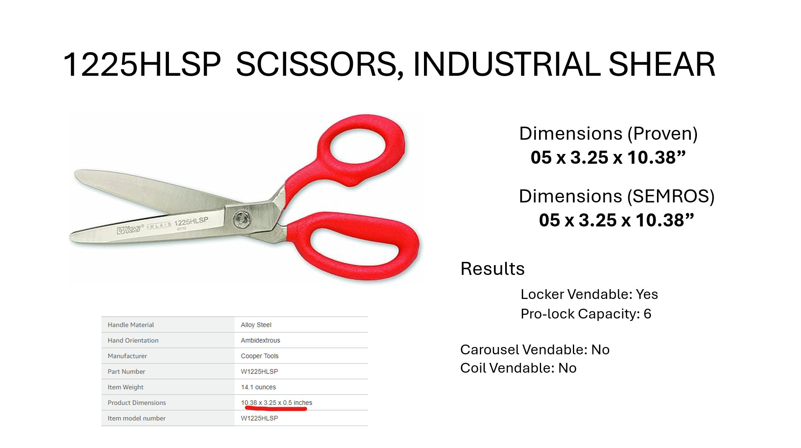

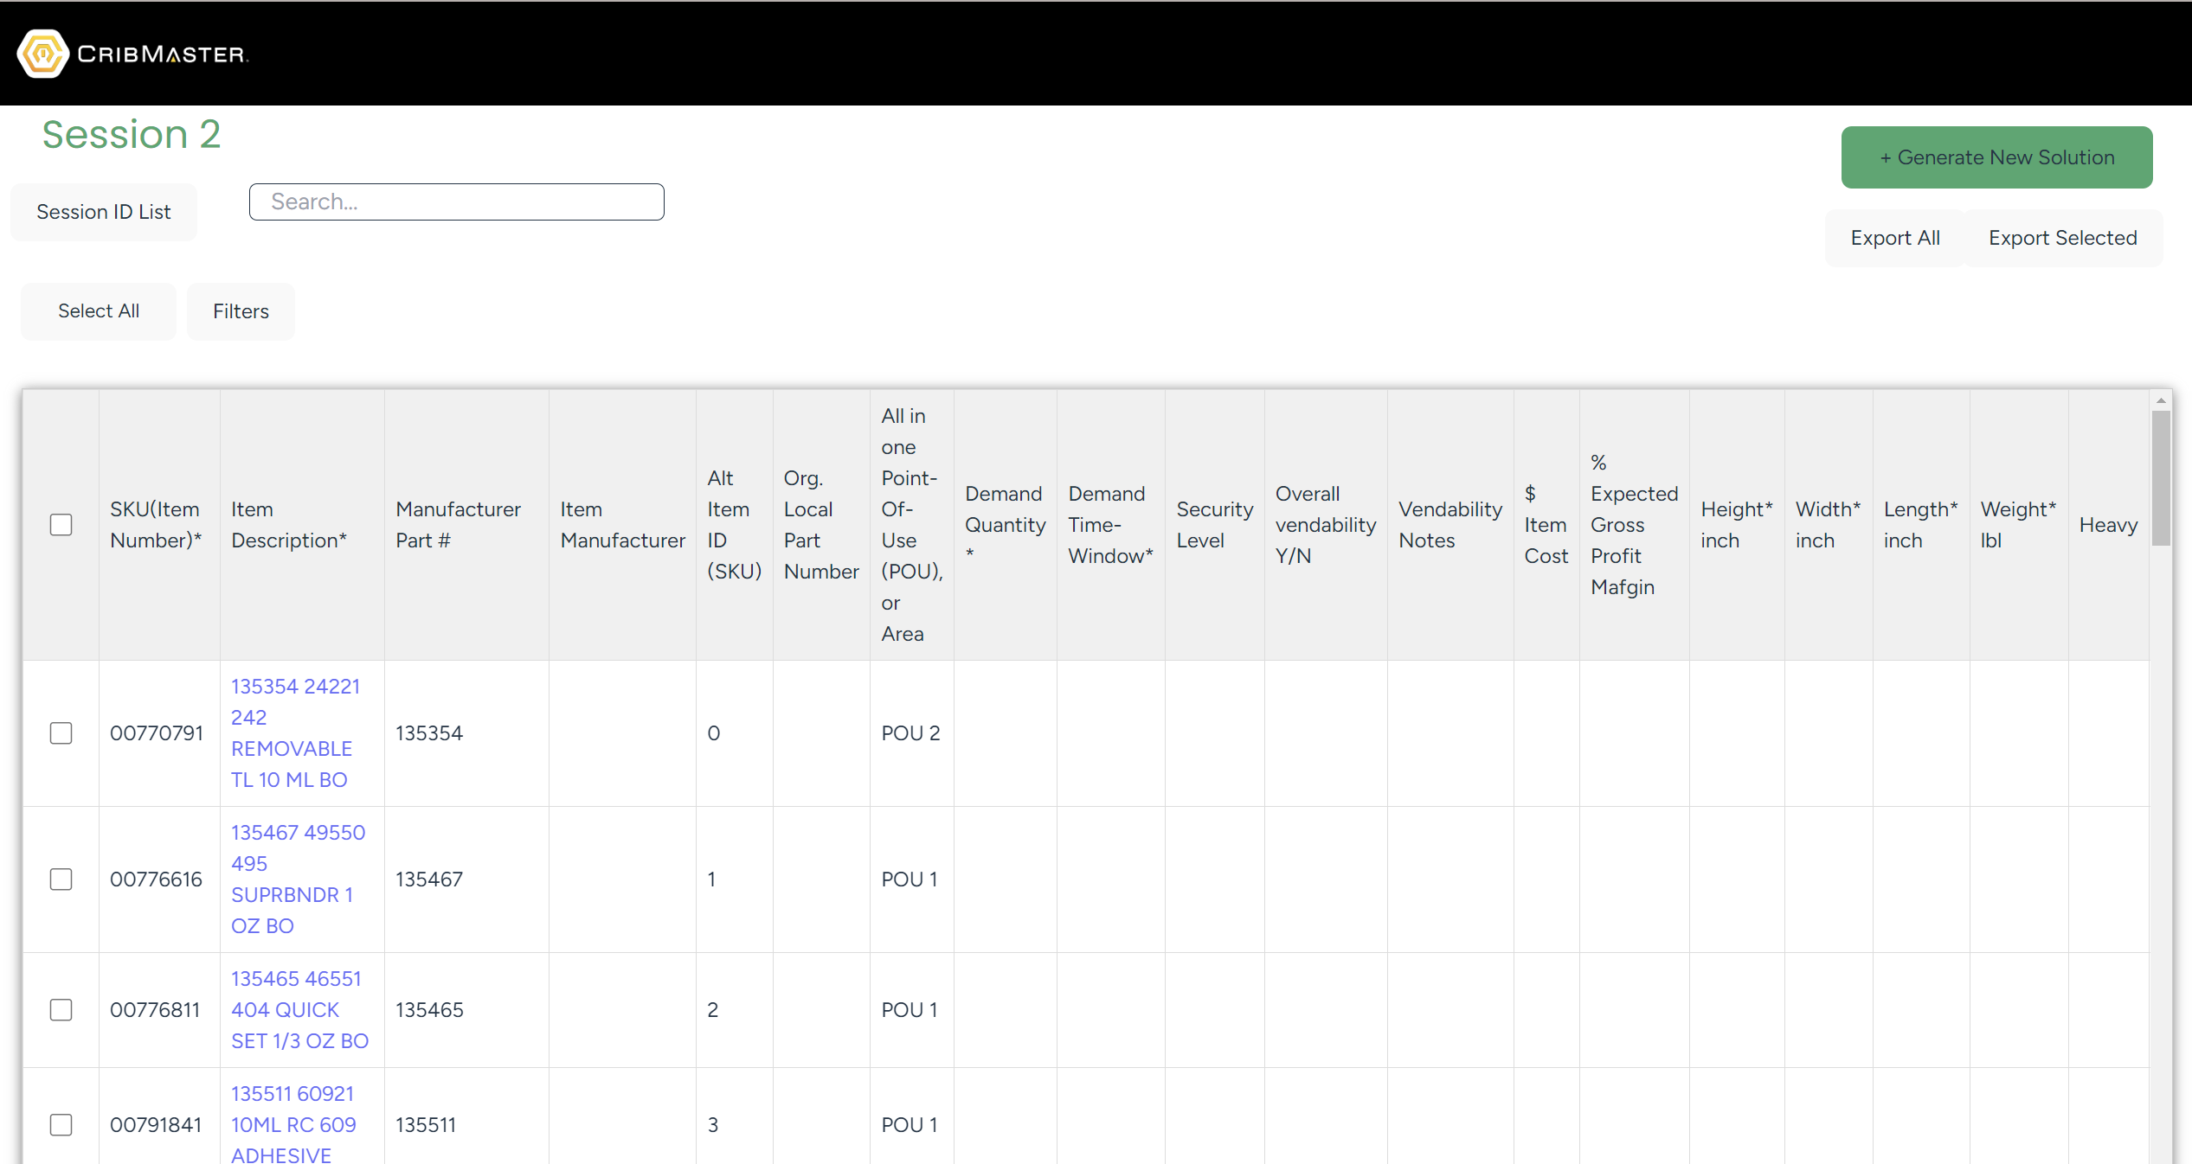

UC-64
CribMaster Smart Evaluator of MRO Supplies Vendibility
Matthew Periut, Cohen Miller, Carter Ray, Dawniqueca Steele, and Justin Hughes
Abstract
The CribMaster Smart Evaluator of MRO Supplies (SEMROS) is a web-based solution analyzing industrial tools and their vending possibilities. It imports client inventory spreadsheets for data collection, which is accomplished through using web scraping and OpenAI API to gather key data like item specification, SKUs, and costs. It evaluates vendibility based on CribMaster hardware solutions, calculating suitability for storage methods. Results are stored for efficiency in future assessments. SEMROS aims to streamline inventory research for CribMaster’s sales team, reducing manual data gathering and vendibility determination, ultimately providing a comprehensive list of items and their vendibility option.
Results
Primary Functions of the Smart Evaluator
The system will allow users to generate sessions and access both new and old sessions through the use of session IDs.
The user will be able to upload .xlsx and .csv files into the software, which will be displayed in a table.
The user can request the system to perform data generation and vendibility analysis, which will update the table and software database.
The user can export the generated information as an .xlsx file for further use.
Conclusions
The development of the CribMaster Smart Evaluator of MRO Supplies has demonstrated promising results and capabilities in automating data collection and vendibility assessments, in which it is able to gather more than 50% of appropriate data for each item. Vendibility tests have also provided feasible insights into item suitability for CribMaster machines, which will streamline research and decision-making processes for sales representatives. Overall, SEMROS’s current state and ongoing refinement creates a reliable platform for CribMaster employees, in which manual effort is reduced and productivity is enhanced. Future improvements to this system can include adding AI generated confidence values, human validation, and more spatial reasoning to our algorithms.
Introduction
CribMaster of Stanley Black and Decker is a company that specializes in inventory management solutions. Their primary mission is to provide clients with advanced inventory management capabilities using industrial-grade, highly customizable vending machines.
CribMaster sale representatives and personnel spend many man-hours gathering and analyzing item data based on a client’s inventory in order to provide them with appropriate hardware solutions. In order to increase both the speed and efficiency of this task, CribMaster is requesting a solution that automates this process.
Acknowledgments
Vladimir Rusanov and Amir Reza Kashani, Project Sponsors and employees of CribMaster
Dr. Yan Huang, Senior Capstone Professor at Kennesaw State University
Figure 2 (above): Example of results from the software. The system is able to determine dimensions, alongside any other critical information, and calculate potential vendibility possibilities for locker, coil, and carousel type vending machines.
Project Goals
The two main goals of the project were to:
Implement data generation and collection algorithms that would search the Internet for key information on specified items;
Calculate vendibility possibilities using the data collected;
With the calculated information, the system will produce an output of a comprehensive excel spreadsheet for the user.
Contact Information
Matthew Periut - mperiut1@students.kennesaw.edu
Cohen Miller - cmill283@students.kennesaw.edu
Carter Ray - cray62@students.kennesaw.edu
Dawniqueca Steele - dsteel26@students.kennesaw.edu
Justin Hughes - jhugh146@students.kennesaw.edu
Figure 1 (above): Backend architecture of system.
View our project website!
Materials and Methods
The Smart Evaluator is structured using a Node.js backend and React frontend, with a mixture of vanilla CSS and Tailwind for styling/layout. Additionally, a MongoDB cloud database is used to store all imported and eventually generated data.
To generate data, The system parses limited information given about an item and performs a search engine query. The query will provide sites that keywords can be found on. Then, web-scraping calls are made on each of these sites, where 50 words on each side of keywords are collected. This is then loaded into a ChatGPT call that finishes gathering and sorting the data. Once data is found on an item, then the system will perform a vendibility analysis. Based on its weight, height, depth, length, and other critical physical properties, the system will mathematically determine if the item is suitable for placement in a selection of CribMaster machines.
Figure 2 (above): User work dashboard, which depicts an uploaded spreadsheet.

